Slide 1
Maze Solving With Informed and Uninformed Search Methods
Arianna Escobar-Reyes
Notes:
corben

Slide 2
Maze Description
The typical maze designs contain the following:
A border surrounding the entire design
A start and finish position
A path from start to finish
Paths that lead to dead ends
Not all mazes have dead ends, but it's common to have them. Our maze 4 is an example where there are multiple possibilities to go from start to finish and no dead ends.

Slide 3
General Implementation for All Searches
While there are differences that make these searches unique, the implementations are almost nearly the same. These algorithms generally do the following steps:
Explore unexplored nodes
Checks if the player can move up, down, left, or right without hitting a wall
Checks if a node has been explored
Determine if the goal node has been reached
Animates the process from start to finish once the goal node is reached.
Compute the path if the goal node has been reached while mentioning the number of steps it took
Prints the number of nodes explored
Compute none if the maze is unsolvable

Slide 4
Uninformed Searches - BFS and DFS
In our implementations, we have solved the maze using BFS and DFS search. There is no information to determine which node to explore next, hence uninformed searches. The differences between the two searches are the following:
BFS - Breadth First Search
Uses queue - first in, last out
By using queue, we explore each neighboring node to the current node
DFS - Depth First Search
Uses stack - last in, first out
By using stack, we explore the first neighboring node then the neighboring node of that node, and so on

Slide 5
Informed Searches - Greedy and A* Search
In our implementations, we have solved the maze using greedy and A* search. These searches use heuristics to determine the next node to explore, hence informed search. The differences between the two searches are the following:
Greedy Search
Uses heap priority queue, which sorts unexplored nodes by the heuristic f(n) = h(n) in increasing order
h(n) = The Manhattan distance of the current node to goal node
A-Star (A*) Search
Uses heap priority queue, which sorts unexplored nodes by the heuristic f(n) = g(n) + h(n) in increasing order
g(n) = The distance (depth level) of the starter node to current node
h(n) = The Manhattan distance of the current node to goal node

Slide 6
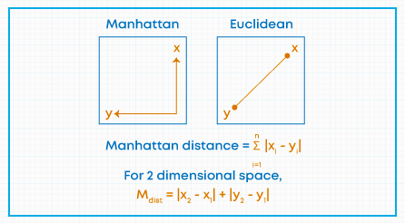
What is Manhattan Distance?
At right angles, we compute the distances from two points to determine the Manhattan distance.
We use Manhattan distance as our h(n) for greed and A* search.
Source: https://www.mygreatlearning.com/blog/hierarchical-clustering/

Slide 7
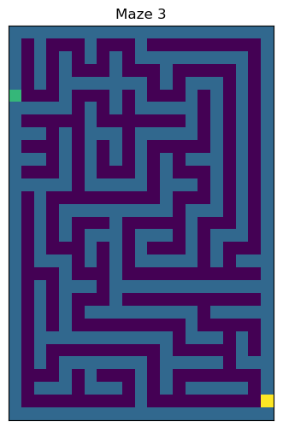
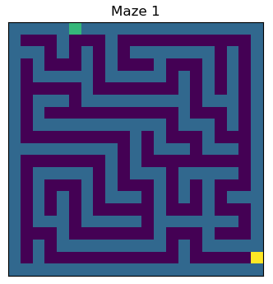
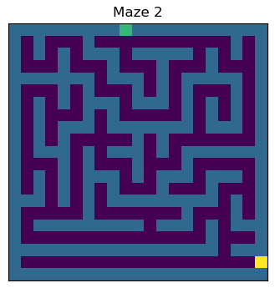
Mazes 1-3

Slide 8
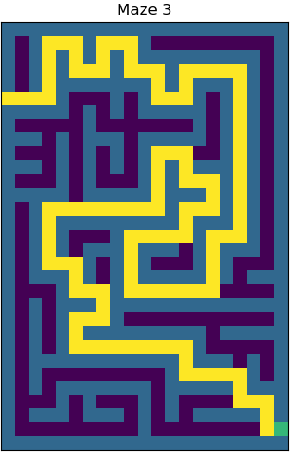
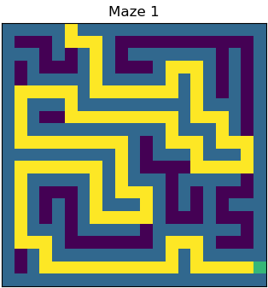
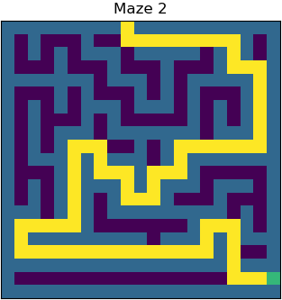
Mazes 1-3 Results By All Searches

Slide 9
Maze 4 Results By Each Search

Slide 10
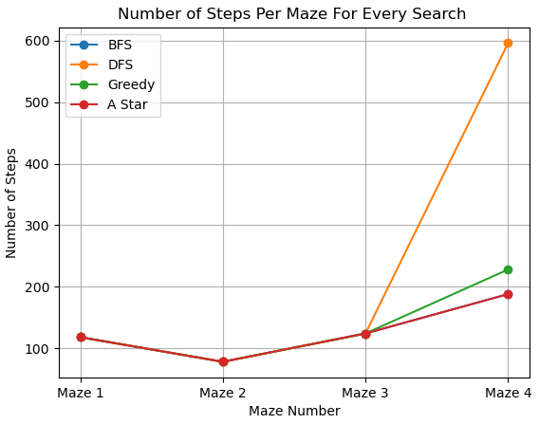
Number of Steps Per Maze For Every Search
For mazes 1, 2, and 3, the number of steps are equally the same for all searches.
We see the most difference in the number of steps for maze 4 where DFS takes the most amount of steps out of the four.
BFS and A* search take the same number of steps for all four mazes. They overlap each other on the graph due to this.
Notes:
corben start

Slide 11
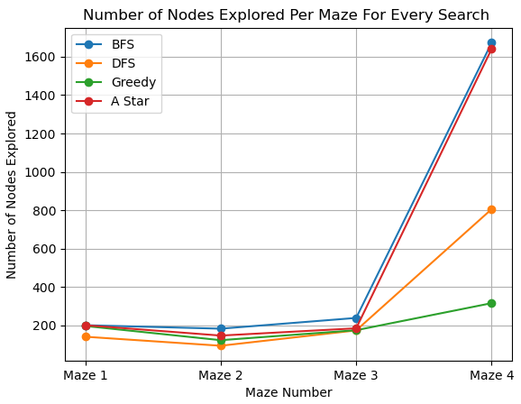
Number of Nodes Explored Per Maze For Every Search
BFS and A* search explore the most amount of nodes out of the four searches.
While they are almost the same, BFS explored more nodes than A* search.
For the first three mazes, DFS has explored the least amount of nodes.
Greedy search explored the least amount of nodes for maze 4.

Slide 12
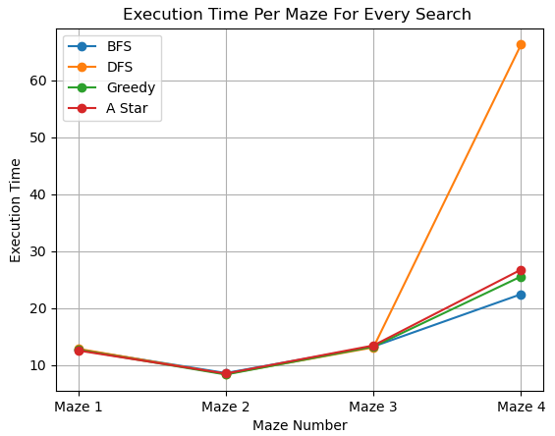
Execution Time Per Maze For Every Search
For the first three mazes, all four searches have around the same execution time.
For the last maze, DFS has the longest execution time. This is because DFS takes the most amount of steps to solve maze 4.
For the other searches, we notice that A* search takes longer than greedy search.
Overall, BFS has the fastest execution time, which can be seen in maze 4.
Notes:
corben end

Slide 13
Sources
https://www.mygreatlearning.com/blog/hierarchical-clustering/
https://www.thealexandrian.net/creations/rappanathuk/level7a-mazes.html
https://medium.com/analytics-vidhya/maze-generations-algorithms-and-visualizations-9f5e88a3ae37
Russell, S. J. (Stuart J., & Norvig, P. (1995). Artificial Intelligence : A Modern Approach. Prentice Hall.

Slide 14
Questions?

Slide 15
Thank you for joining our presentation!

